Slide 1
Vector Spaces
NULL SPACES, COLUMN SPACES, AND LINEAR TRANSFORMATIONS

Slide 2



NULL SPACE OF A MATRIX
Definition: The null space of an matrix A, written as Nul A, is the set of all solutions of the homogeneous equation . In set notation,
.
Theorem 2: The null space of an matrix A is a subspace of . Equivalently, the set of all solutions to a system of m homogeneous linear equations in n unknowns is a subspace of .
Proof: Nul A is a subset of because A has n columns.
We need to show that Nul A satisfies the three properties of a subspace.

Slide 3




NULL SPACE OF A MATRIX
0 is in Null A.
Next, let u and v represent any two vectors in Nul A.
Then
and
To show that is in Nul A, we must show that
.
Using a property of matrix multiplication, compute
Thus is in Nul A, and Nul A is closed under vector addition.

Slide 4

NULL SPACE OF A MATRIX
Finally, if c is any scalar, then
which shows that cu is in Nul A.
Thus Nul A is a subspace of .
An Explicit Description of Nul A
There is no obvious relation between vectors in Nul A and the entries in A.
We say that Nul A is defined implicitly, because it is defined by a condition that must be checked.

Slide 5
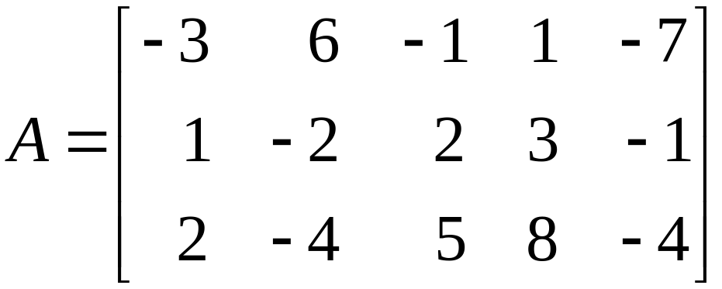
NULL SPACE OF A MATRIX
No explicit list or description of the elements in Nul A is given.
Solving the equation amounts to producing an explicit description of Nul A.
Example 1: Find a spanning set for the null space of the matrix
.

Slide 6
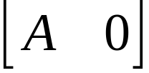
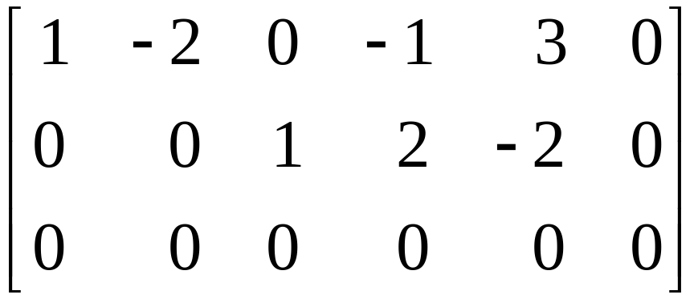
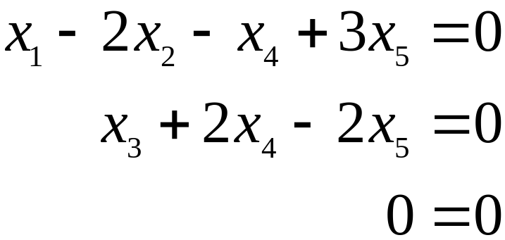
NULL SPACE OF A MATRIX
Solution: The first step is to find the general solution of in terms of free variables.
Row reduce the augmented matrix to reduce echelon form in order to write the basic variables in terms of the free variables:
,

Slide 7
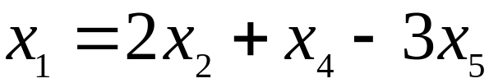
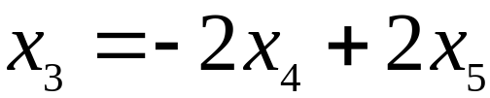
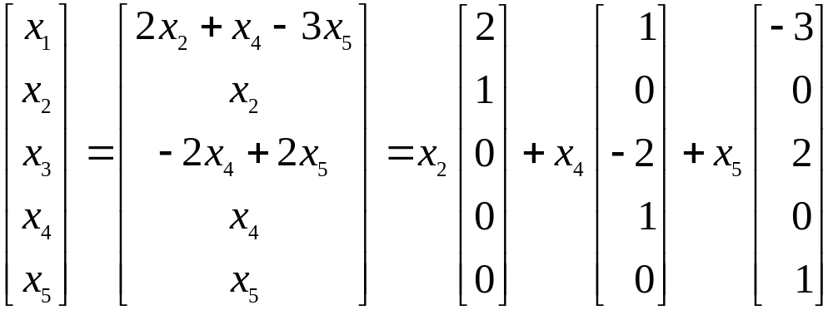
NULL SPACE OF A MATRIX
The general solution is ,
, with x₂, x₄, and x₅ free.
Next, decompose the vector giving the general solution into a linear combination of vectors where the weights are the free variables. That is,
u
v
w

Slide 8
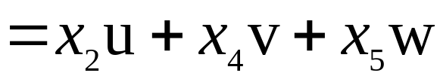
NULL SPACE OF A MATRIX
. ----(1)
Every linear combination of u, v, and w is an element of Nul A.
Thus {u, v, w} is a spanning set for Nul A.
    The spanning set produced by the method in Example (1) is automatically linearly independent because the free variables are the weights on the spanning vectors.
    When Nul A contains nonzero vectors, the number of vectors in the spanning set for Nul A equals the number of free variables in the equation .

Slide 9
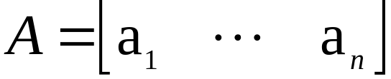
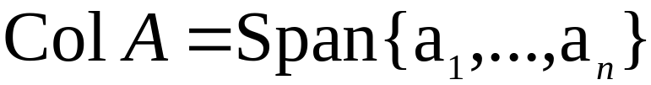

COLUMN SPACE OF A MATRIX
Definition: The column space of an matrix A, written as Col A, is the set of all linear combinations of the columns of A. If , then
.
Theorem 3: The column space of an matrix A is a subspace of .
A typical vector in Col A can be written as Ax for some x because the notation Ax stands for a linear combination of the columns of A. That is,
.

Slide 10


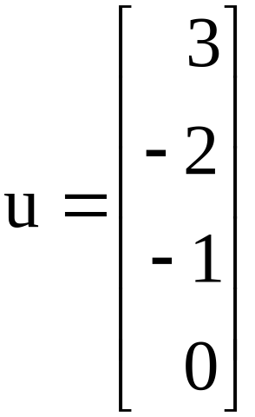
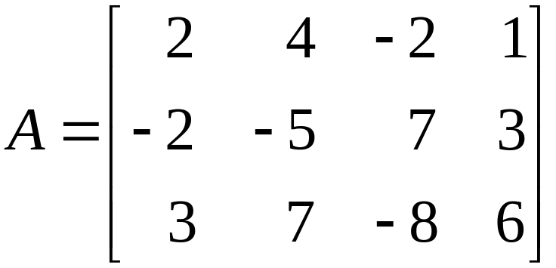
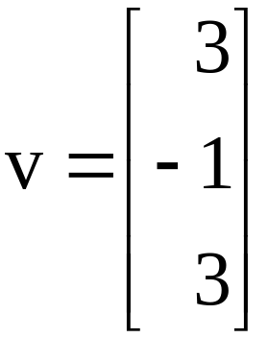
COLUMN SPACE OF A MATRIX
The notation Ax for vectors in Col A also shows that Col A is the range of the linear transformation .
The column space of an matrix A is all of if and only if the equation has a solution for each b in .
Example 2: Let ,
and .

Slide 11
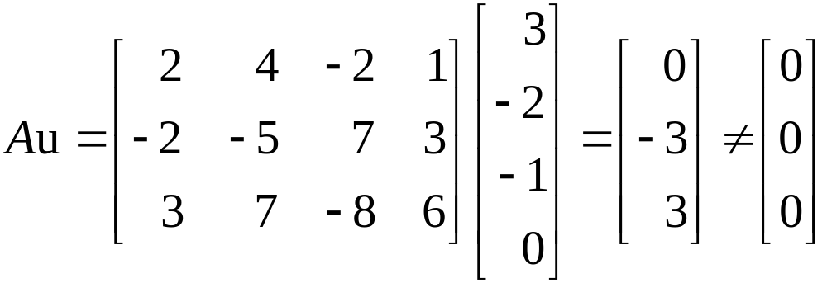
COLUMN SPACE OF A MATRIX
    Determine if u is in Nul A. Could u be in Col A?
    Determine if v is in Col A. Could v be in Nul A?
Solution:
    An explicit description of Nul A is not needed here. Simply compute the product Au.

Slide 12


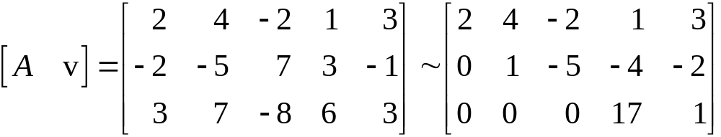

COLUMN SPACE OF A MATRIX
u is not a solution of , so u is not in Nul A.
Also, with four entries, u could not possibly be in Col A, since Col A is a subspace of .
    Reduce to an echelon form.
      The equation is consistent, so v is in Col A.

Slide 13



KERNEL AND RANGE OF A LINEAR TRANSFORMATION
      With only three entries, v could not possibly be in Nul A, since Nul A is a subspace of .
Subspaces of vector spaces other than are often described in terms of a linear transformation instead of a matrix.
Definition: A linear transformation T from a vector space V into a vector space W is a rule that assigns to each vector x in V a unique vector T (x) in W, such that
    for all u, v in V, and
    for all u in V and all scalars c.

Slide 14

KERNEL AND RANGE OF A LINEAR TRANSFORMATION
The kernel (or null space) of such a T is the set of all u in V such that (the zero vector in W ).
The range of T is the set of all vectors in W of the form T (x) for some x in V.
The kernel of T is a subspace of V.
The range of T is a subspace of W.

Slide 15


CONTRAST BETWEEN NUL A AND COL A FOR AN
MATRIX A
Nul A | Col A
Nul A is a subspace of . | Col A is a subspace of .
Nul A is implicitly defined; i.e., you are given only a condition that vectors in Nul A must satisfy. | Col A is explicitly defined; i.e., you are told how to build vectors in Col A.

Slide 16


CONTRAST BETWEEN NUL A AND COL A FOR AN
MATRIX A
It takes time to find vectors in Nul A. Row operations on are required. | It is easy to find vectors in Col A. The columns of a are displayed; others are formed from them.
There is no obvious relation between Nul A and the entries in A. | There is an obvious relation between Col A and the entries in A, since each column of A is in Col A.

Slide 17

CONTRAST BETWEEN NUL A AND COL A FOR AN
MATRIX A
A typical vector v in Nul A has the property that . | A typical vector v in Col A has the property that the equation is consistent.
Given a specific vector v, it is easy to tell if v is in Nul A. Just compare Av. | Given a specific vector v, it may take time to tell if v is in Col A. Row operations on are required.

Slide 18






CONTRAST BETWEEN NUL A AND COL A FOR AN
MATRIX A
Nul if and only if the equation has only the trivial solution. | Col if and only if the equation has a solution for every b in .
Nul if and only if the linear transformation is one-to-one. | Col if and only if the linear transformation maps onto .

